Slide 1

Second BAI Meeting

Slide 2
Housekeeping
Website (As soon as we get this we can submit UBS Club Directory)
Slack (Text me your email I will add you)
Instagram ?
LinkedIn
Reserving Room

Slide 3
Email Information
Email: bruinalphainvestment26@gmail.com
Password: MaxHemler=Sk1rtB0y

Slide 4
Committee Ideas

Slide 5
Internal Logistics
And a few notes**

Slide 6

We the People

Slide 7
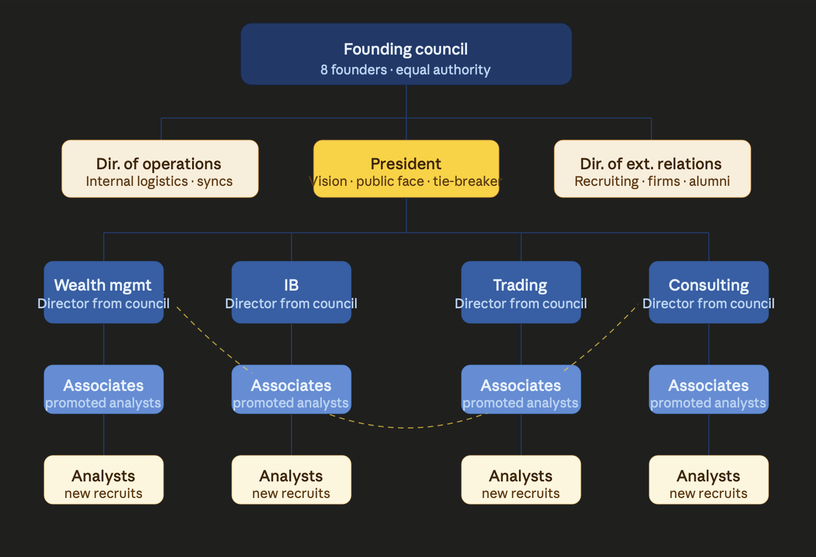

Slide 8
Have Passion, Believe in Legacy, Believe in BAI

